Slide 1
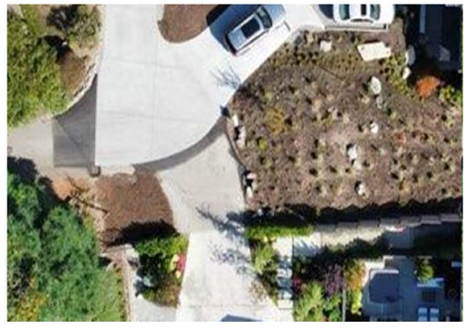
Yang / City of Mercer Island
Appeal Number APL21-006
EX. 1018

Slide 2
Trust the Process
Appeal Number APL21-006
Cities are obligated to follow their prescribed process
The process here should have been sufficient for the Yangs to trust the process
  Development Manuel Required Proof of Access
  MICC requires consent of “Affected” Property
  MICC 19.15.070 mandates that the City must only accept complete applications
  MICC 19.02.050(E)(1)(b)(i)(c) requires the City consider safety hazards
  MICC 19.15.060 requires title reports
  MICC 6.10.110 – Easements and use limitations shown on plats are deemed conditions of permit approval
  Yangs were told by the City they will not approve permits pending litigation – Yangs trusted this
But the City failed to follow its Own Processes

Slide 3
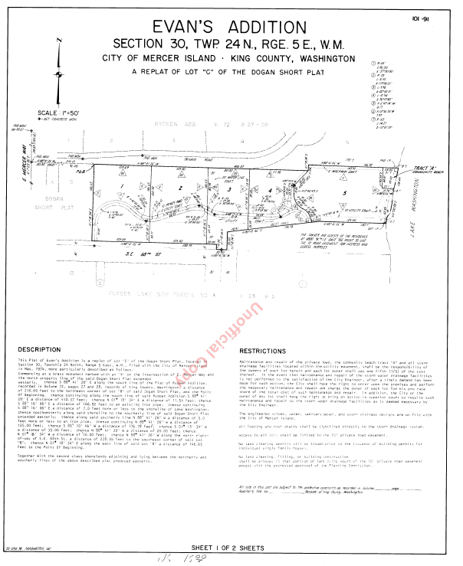
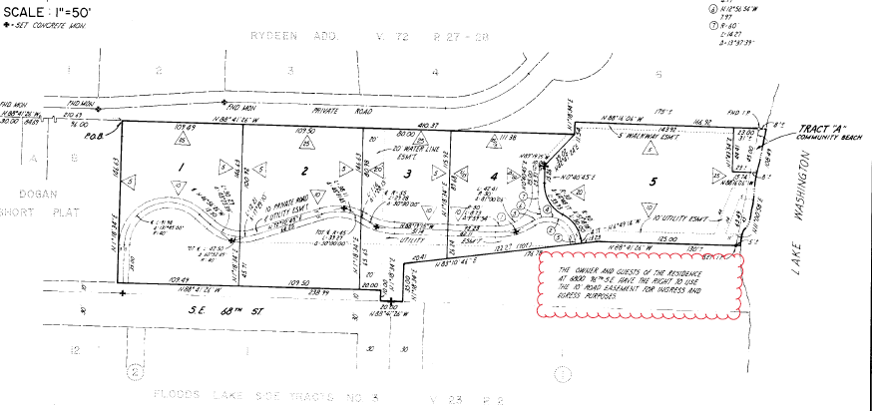

The City Did Not Review Access Rights in Connection with Appealed Permit
THE OWNER AND GUESTS OF THE RESIDENCE AT 6800 96TH S.E. HAVE THE RIGHT TO USE THE 10’ ROAD EASEMENT FOR INGRESS AND EGRESS PURPOSES.
Violated Development Manual and City Code: Applications must be complete / Easement rights must be verified
EX. 1003

Slide 4
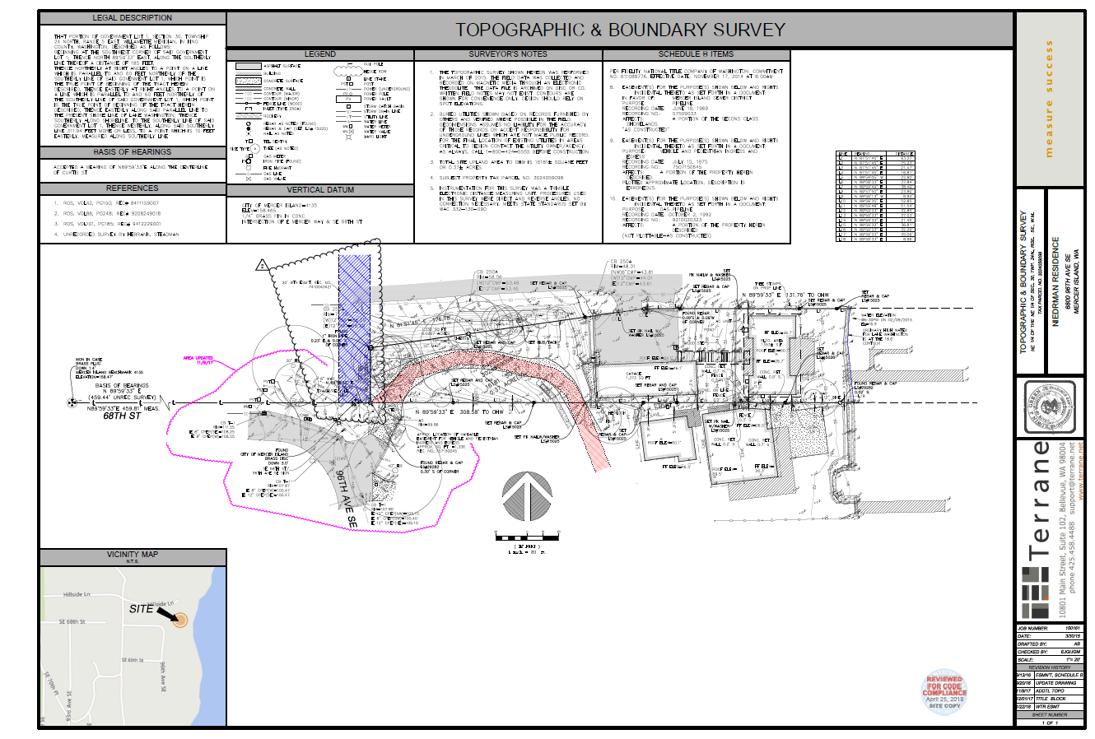
Misalignment made possible by the Niedermans’ omission of the deeded easement access from the Niedermans’ survey when they submitted for permits to the City of Mercer Island when their home was constructed
Survey Omits Deeded Access – doesn’t show any authorized access
EX. 12

Slide 5
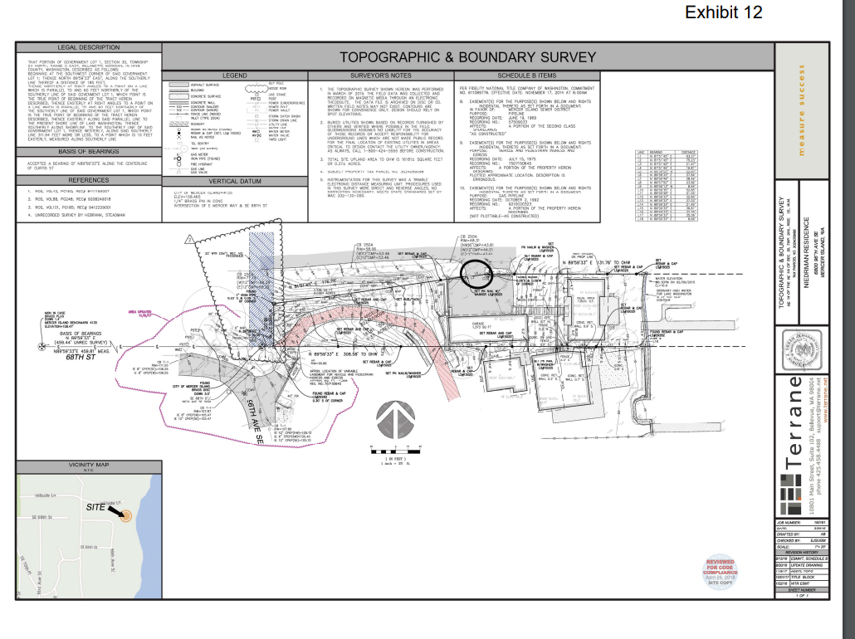
EXHIBIT 12: Did the City repeat the same mistake that caused the entire litigation and review this survey?
NO ACCESS RIGHTS
EX. 1019, p. 4

Slide 6
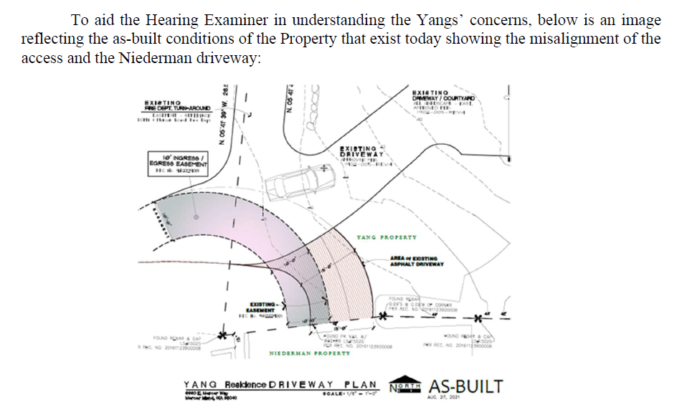
Litigation is Pending to Determine if Deeded Access Will be restored
EX. 1009

Slide 7
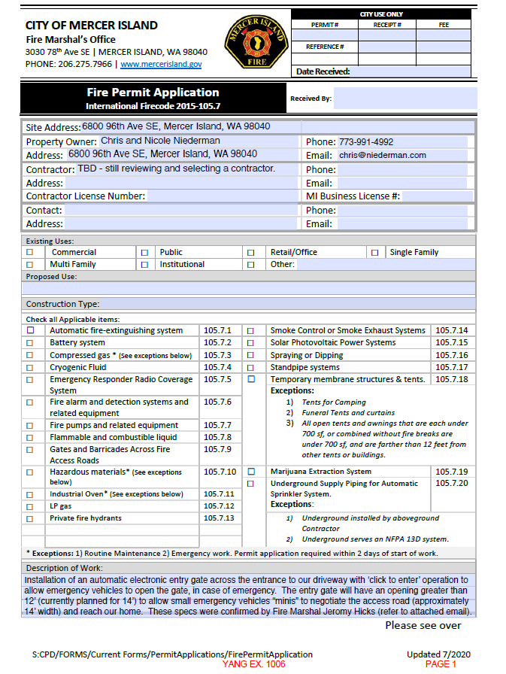
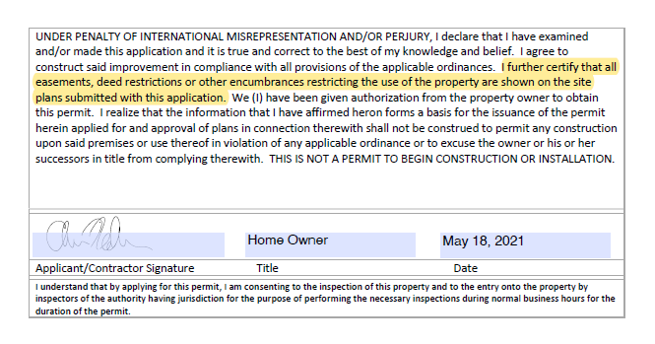

Chris Niederman Lied
I further certify that all easements, deed restrictions or other encumbrances restricting the use of the property are shown on the site plans submitted with this application.
EX. 1006, p. 2

Slide 8
EXHIBIT 12: Did Chris Niederman submit the knowingly false survey or was no survey submitted at all?
NO ACCESS RIGHTS
EX. 12

Slide 9
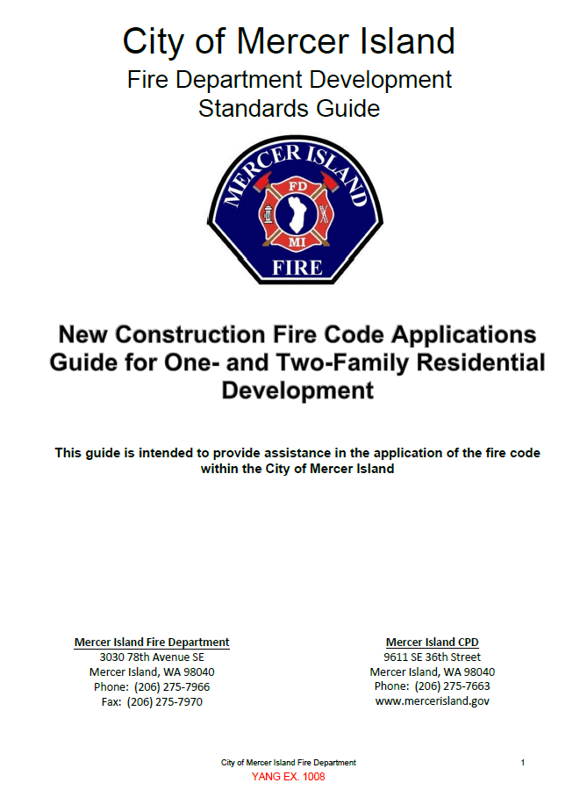
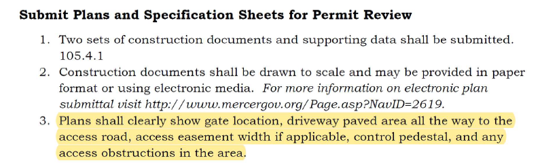
The City Did Not Follow Its Own Process that the Yangs Trusted
The Development Standards Guide is adopted under the
authority of Chapter 19.27 RCW and WAC 51-54A-002 and thus is City administrative law
EX. 1008, p 26

Slide 10
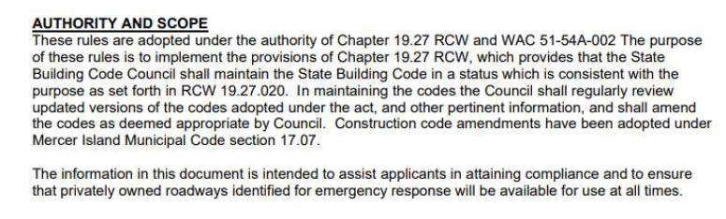
This City’s Trusted Process is Binding Law
  The City adopted a Development Manual for Situations Such As This Which States that the Development Manuel Itself Operates as Binding Law in the City of Mercer Island:

Slide 11
EX. 1008, p. 26
MICC 19.15.070 mandates that the City shall not accept an incomplete application for processing in review. The code provides in pertinent part:
A. Complete Application Required. The city will not accept an incomplete application for processing and review. An application is complete only when all information required on the application form and all submittal items required by the development code have been provided to the satisfaction of the code official.
EX. 1008

Slide 12
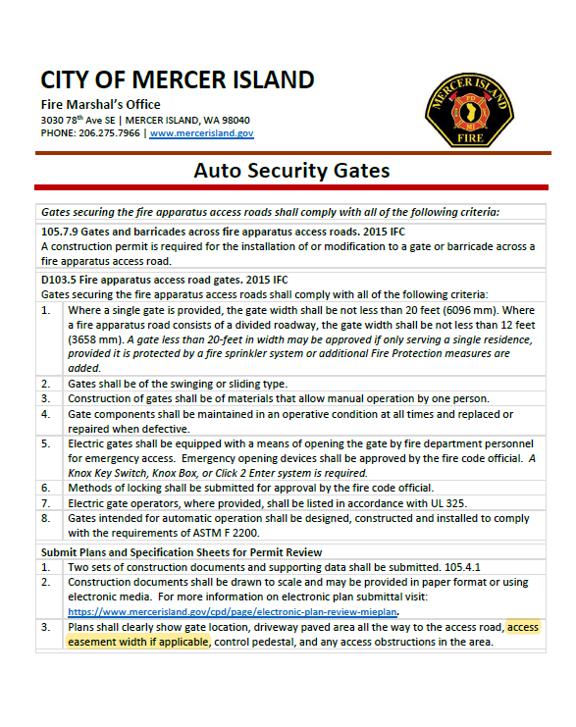


Ex. 1012: Separate publication sent to Niedermans reinforcing requirements
Of development manual
The City approved the application without having all the pertinent information to make its decision and without a complete application for purposes of MICC 19.15.070. The City of Mercer Island application instructions specifically state that “[p]lans shall clearly show gate location, driveway paved area all the way to the access road, access easement width if applicable, control pedestal, and any access obstructions in the area.
EX. 1012

Slide 13
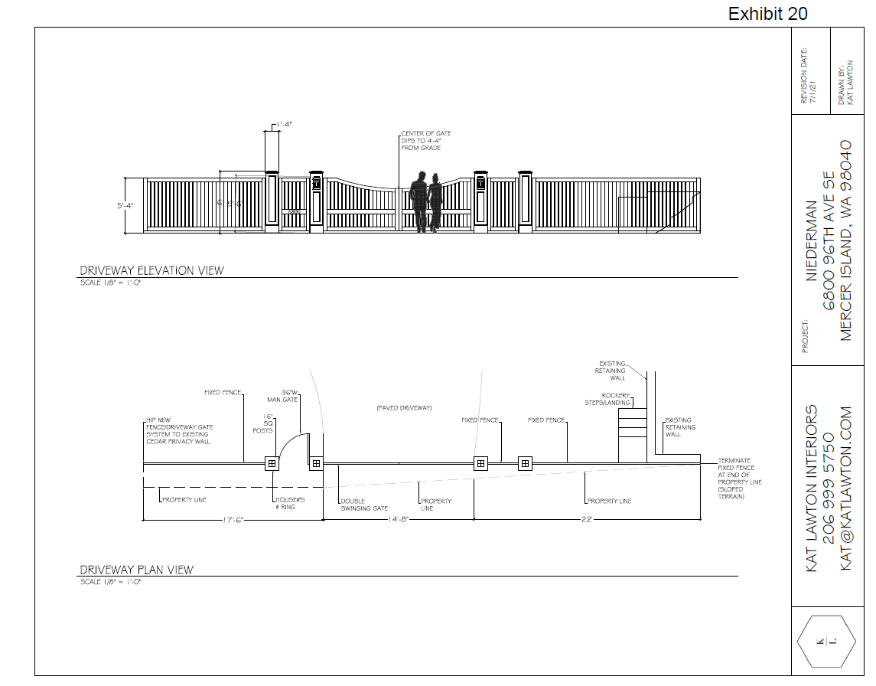
Niedermans’ Gate Will Obstruct the Deeded Access
EX. 20

Slide 14
The Niedermans did not Obtain Consent to the Permit as Required by The Mercer Island City Code
Approval of this permit violates MICC 19.15.060(A)(8), which requires consent of all owners of the “affected property.” “Affected” means “”to produce an effect upon (someone or something).” Affect, Merriam-Webster Dictionary (11th ed. 2003). As discussed below, the Yang Property is an “affected property,” and thus, the Niedermans were required to obtain the Yangs’ consent. One way the Yangs are “affected” by this as referenced in City Code is that the widening of the Niedermans’ access will operate to reduce the “Lot Area” for development purposes as defined in MICC 19.16.010.

Slide 15
The Niedermans Admit That The Gate will Result in Safety Concerns
State courts have held that permit applications “may validly be denied” based on safety
concerns “if substantial evidence shows that the proposed use is likely to . . . result in safety threats from construction.” 2 Am. Law. Zoning § 14:13 n. 1 (5th ed. 2021)(citing various state courts
around the country). Additionally, City Code (which the City cites as applicable in its Staff Report) expressly provides that a gate may “not create a traffic, pedestrian, or public safety hazard.” MCC 19.02.050(E)(1)(b)(ii)(c).
Chris Niederman has explicitly stated under oath that if constructed, the gate is going to create a significant safety hazard. In a September 2, 2021, Declaration, Mr. Niederman testified as follows:
Recently the City of Mercer Island granted us a permit to put up a car gate across our driveway, something we have long planned, and soon there will be no safe way for cars and trucks to turn around at the bottom of the private lane.
EX. 1013

Slide 16
The City Failed to Follow Its Own Process
The Niedermans were required to obtain the Yangs’ consent to the gate as the Yang Property is an “affected property” under MICC 19.15.060(A)(8).
The City approved the application without having all the pertinent information to make its decision and without a complete application for purposes of MICC 19.15.070. The City of Mercer Island application instructions specifically state that “[p]lans shall clearly show gate location, driveway paved area all the way to the access road, access easement width if applicable, control pedestal, and any access obstructions in the area.”
Chris Niederman omitted relevant information from their application that was explicitly required per the instructions and falsely certified that they included all necessary information.
The City’s approval of this application was inappropriate, as it may ultimately have a role in determining the outcome of the litigation.

Slide 17
Trust the Process:
Appeal Number APL21-006
The Yangs Trusted the City’s Process. The same process that had prevented them form modifying the driveway location pending a dispute.
Cities are obligated to follow their prescribed process. The process here should have been sufficient for the Yangs to trust the process
  Development Manuel Required Proof of Access
  MICC 19.15.060(A)(8) requires consent of “Affected” Property
  MICC 19.15.070 mandates that the City must only accept complete applications
  MICC 19.02.050(E)(1)(b)(i)(c) requires the City consider safety hazards
  MICC 19.15.060 requires title reports
  MICC 6.10.110 – Easements and use limitations shown on plats are deemed conditions of permit approval
  Yangs were told by the City they will not approve permits pending litigation – Yangs trusted this
But the City failed to follow its Own Processes. The City Failed The Yangs.
Accordingly, the Yangs ask that the Hearing Examiner reverse the City of Mercer Island’s approval of Permit No. 2105-227.

